Slide 1
Core Java – Part 5

Slide 2
What we will cover today?
Exceptions
Errors
Try
Catch
Finally
Usage of throws and throw keywords
Creating your own Exceptions

Slide 3
What is an Exception?
“Exceptional Condition” that alters the normal program flow.
Many things can lead to an exception.. Like:
Hardware failure
Resource not available
Good old bugs
Exception Handler
It is the code that is responsible for doing something when any exception occurs.
It catches the thrown Exception

Slide 4
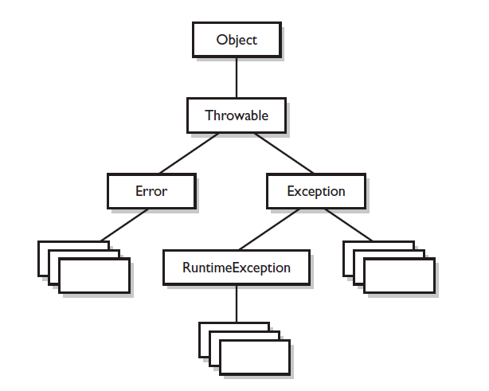
Exception Hierarchy

Slide 5
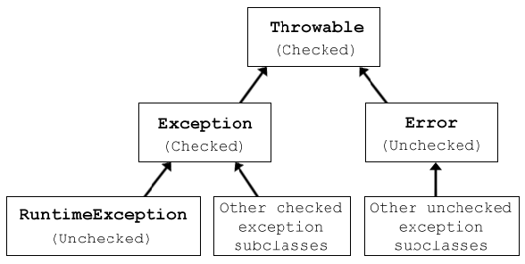
What is checked & Unchecked?

Slide 6
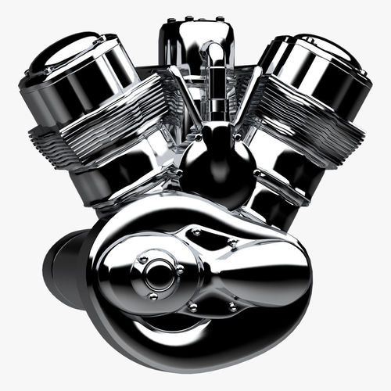
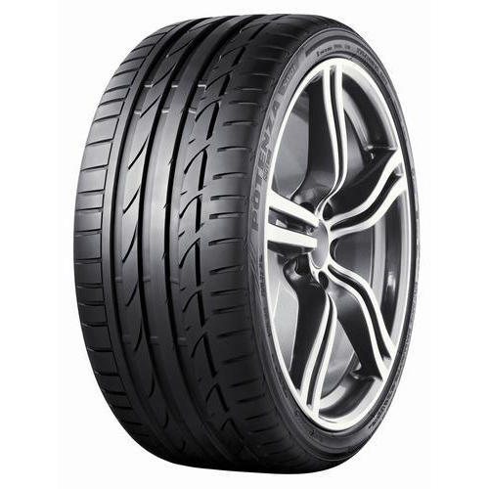
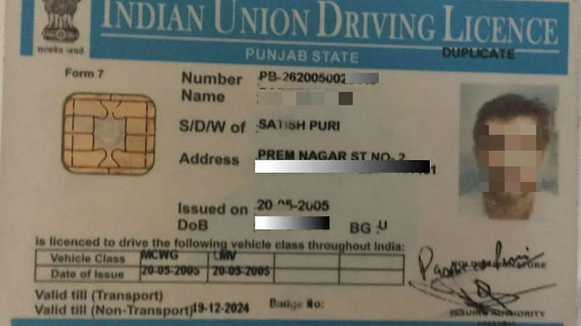
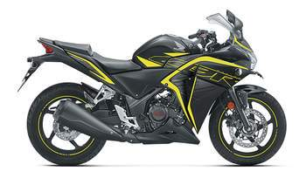
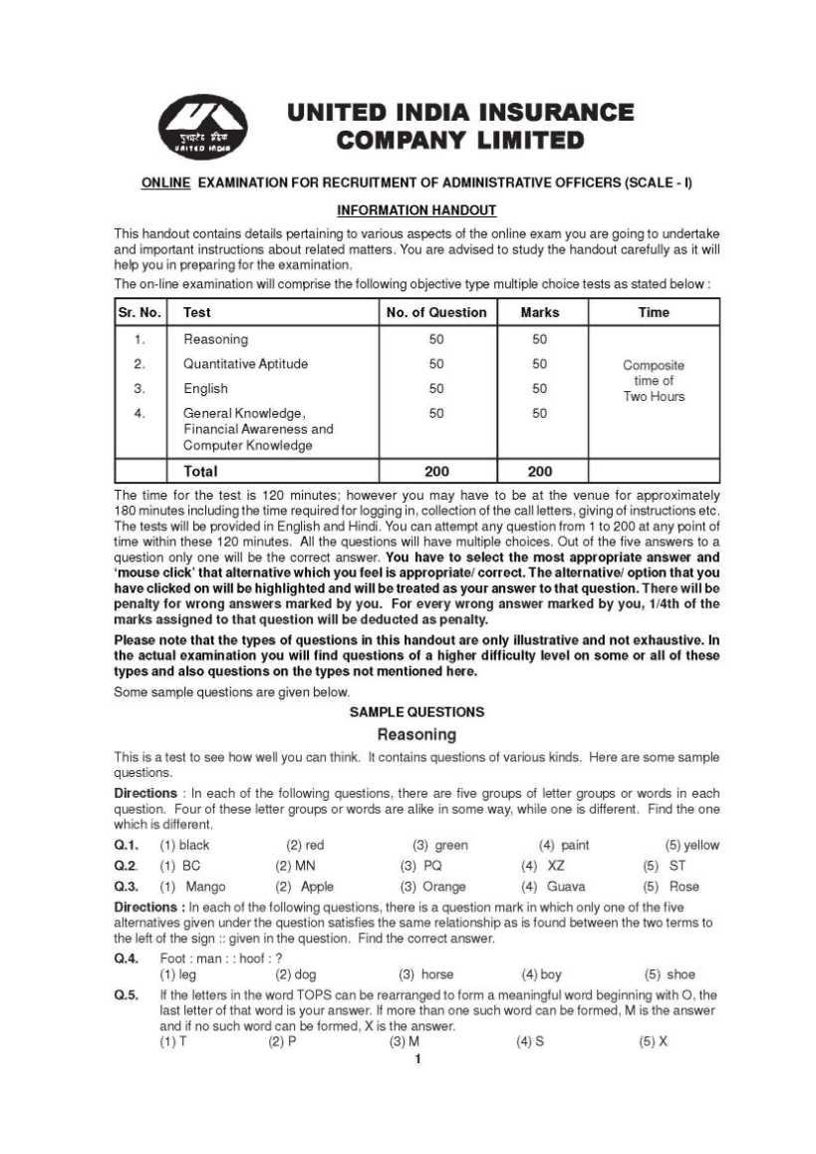




Imagine…
Brakes

Slide 7

Security

Slide 8
Input
Output
Opera-tions
Compiler
Security

Slide 9
Checked Exceptions
SQLException
IOException
DataAccessException
ClassNotFoundException
InvocationTargetException
Unchecked Exception
NullPointerException
ArrayIndexOutOfBoundsException
ArithmeticException
IllegalArgumentException

Slide 10
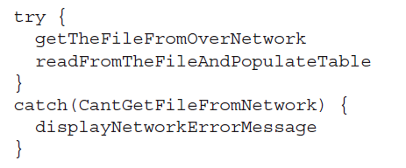
The way we work with exceptions…

Slide 11
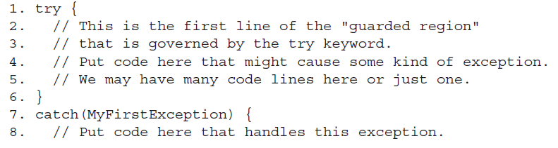
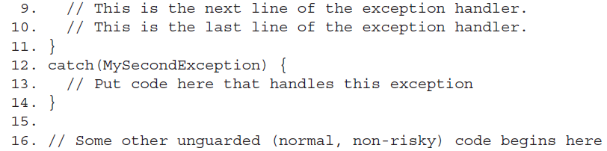
Catching an Exception using try/catch…

Slide 12
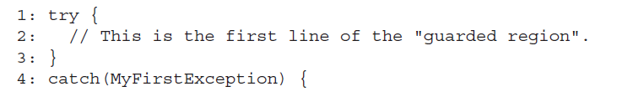
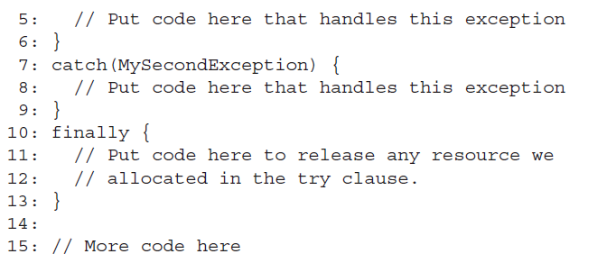
Using Finally
Used for clean up tasks.
ex: 1. closing database connection
2. closing network connection
3. Closing the file already opened for reading etc..

Slide 13
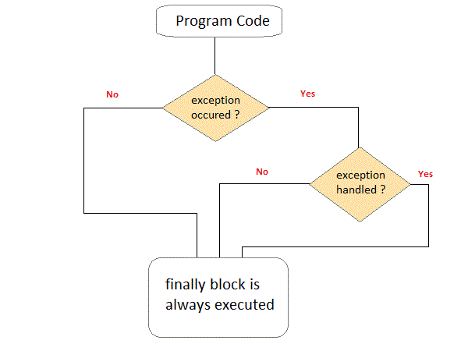
finally..

Slide 14
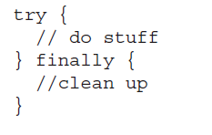



Is it legal?
Is it legal?
Is it legal?

Slide 15
Write this on your body !!
Each method must either handle all checked exceptions by supplying a “catch” clause or list each unhandled checked exception as a “throws” exceptions.
“Handle or Declare”

Slide 16
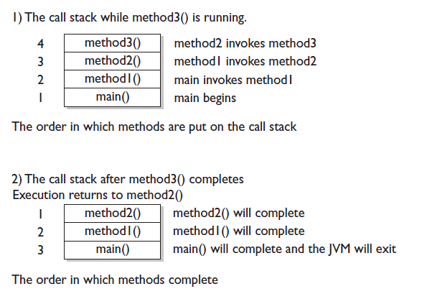
Java method call stack…

Slide 17

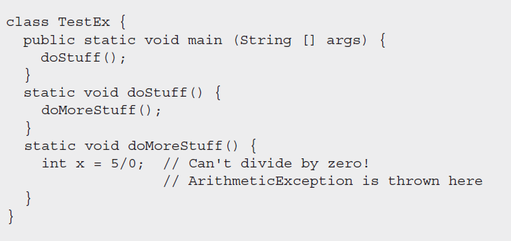

Slide 18
throw Keyword
throw keyword is used to throw an exception explicitly. Only object of Throwable class or its sub classes can be thrown. Program execution stops on encountering throw statement, and the closest catch statement is checked for matching type of exception.
Syntax :
throw ThrowableInstance

Slide 19
Difference between..
throw | throws
throw keyword is used to throw an exception explicitly. | throws keyword is used to declare an exception possible during its execution.
throw keyword is followed by an instance of Throwable class or one of its sub-classes. | throws keyword is followed by one or more Exception class names separated by commas.
throw keyword is declared inside a method body. | throws keyword is used with method signature (method declaration).
We cannot throw multiple exceptions using throw keyword. | We can declare multiple exceptions (separated by commas) using throws keyword.

Slide 20
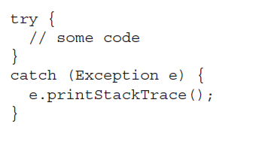
Resist the temptation to write code like this…

Slide 21
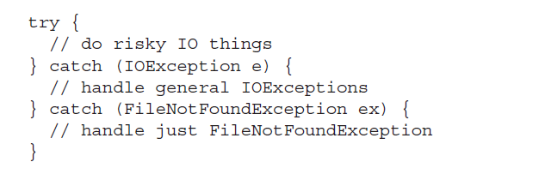
Exception Matching

Slide 22

What is an Error ?
StackOverflowError
OutOfMemoryError

Slide 23
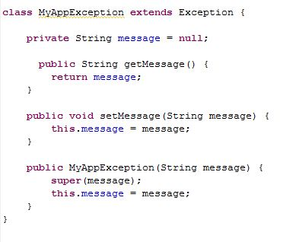
Creating your own exception and using it..

Slide 24

Any Question ?

Slide 25

Thank you !

